Slide 1
Advanced higher Graphic communication
Graphic Types and Techniques
Audiences, Purpose and Benefits

Slide 2
Learning intentions & success criteria
Learning Intentions
Introduction to different graphic types
Success Criteria
Understand and create a Gantt chart
State the intended audience for different graphic types
Explain the benefits of particular graphics

Slide 3
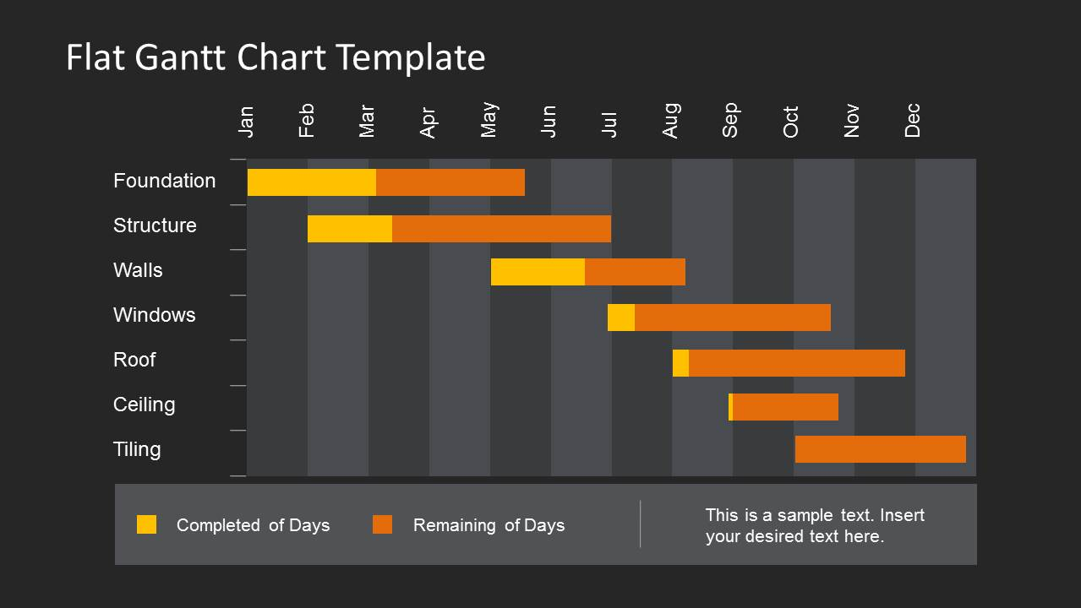
Gantt charts
Gantt charts are used to visually plan and allocate time to tasks which are required to be completed as part of the a project.

Slide 4
Gantt charts
Each individual task is given a start date and deadline for completion. These charts allow those who are in charge of the projects to track the progress of the project ensuring that all tasks are completed on time.

Slide 5
Gantt charts
Gantt charts also show the sequence of tasks, the dependency of one task on another and what tasks can be undertaken concurrently.

Slide 6
Gantt charts
You can also work out from the Gantt chart what type of workforce are needed

Slide 7
Gantt charts
AUDIENCE:
Project Managers
Lead Designer
Manufacturing Engineering
Quantity Surveyor

Slide 8
Gantt charts
BENEFITS:
This visual method helps users to understand the length of time each task has in proportion to the other tasks.
It also helps to minimise down time, work out man power requirements, sequence of tasks and make contingency plans.

Slide 9
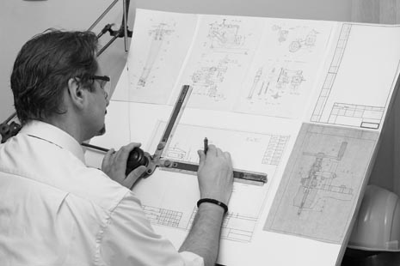
Manual sketching
PURPOSE:
Manual sketching is a skill that is used during the preliminary phase of the design process.
It enables the designer to record the ideas quickly; it is immediate.
Manual sketches are also used to communicate early stages of the design process with either clients or other professionals before the time is then spent creating production or promotional materials.
Free-hand sketching can also be done on an electronic sketch pad which enables ease of editing, aids electronic communication and can be saved in different file formats etc.

Slide 10
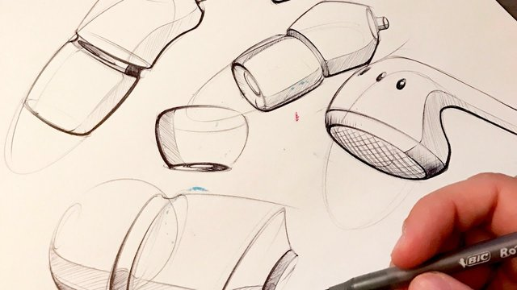
Manual sketching
AUDIENCE:
Designers
Engineers
Joiners
Clients
BENEFITS:
Sketching is a quick and immediate process and allows the designer to produce and record a range of solutions quickly.
These ideas can then be shown to and discussed with the design team. If mistakes are made during this phase then they are quick and inexpensive to fix.
Creates 2D and pictorial sketches which can be scanned and sent to clients or team members.

Slide 11
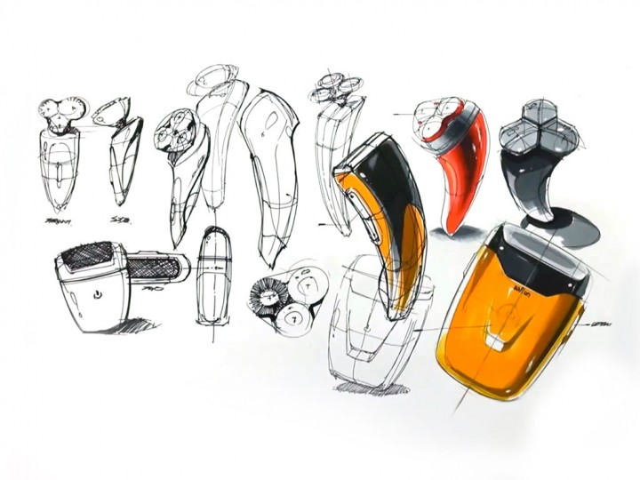
illustrations
PURPOSE:
Illustrations are used to share design ideas with Clients.
These promotional graphics use light, shade, texture, materials and environments to create realistic renderings of products that Clients will be able to visualise and gain an understanding of what the final manufactured product will look like.
Illustrations can also be used for promotional materials i.e. billboard

Slide 12
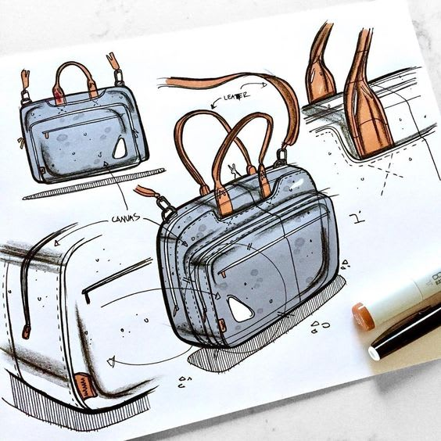
illustrations
AUDIENCE:
Clients
Customers
Design team
BENEFITS:
Final ideas can be shared with clients without the expensive cost of creating a prototype.
Files are easily sent digitally.
Products can be visualised in a range of environments and lighting conditions without the expense of photographing a prototype in numerous locations.

Slide 13
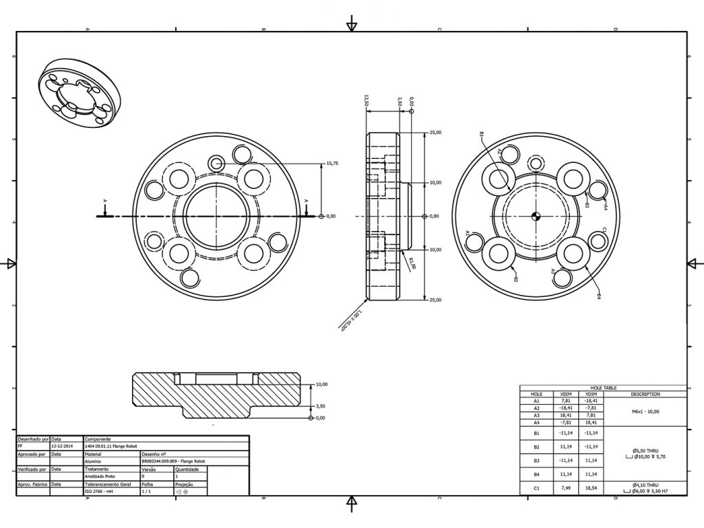
Cad production drawings
PURPOSE:
To allow the product to be manufactured using CAD/CAM.
AUDIENCE:
Engineer
Assembly technician

Slide 14
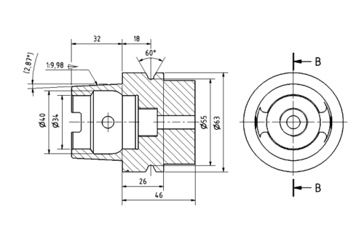
Cad production drawings
BENEFIT:
Can simulate prior to manufacture to see if it works/fits together.
Easily modified.
Can support manufacture through CNC processes: geometric information sent directly to manufacturing machines.
Can support rapid prototyped modelling e.g. 3D printing

Slide 15
Orthographic projection
PURPOSE:
Representing 3D objects as 2D. It is a universally understood drawing method and the application of appropriate drawing standards means that the drawing can be readily understood by all users.

Slide 16
Orthographic projection
AUDIENCE:
Engineer
Building Contractor
BENEFIT:
Can show section/detail views for specific requirements or trades. Shows true shapes of surfaces.
Always drawn to scale.
Can be easily dimensioned. Can show internal details and technical details required by the manufacturer.
The use of symbols and standards communicates globally.

Slide 17
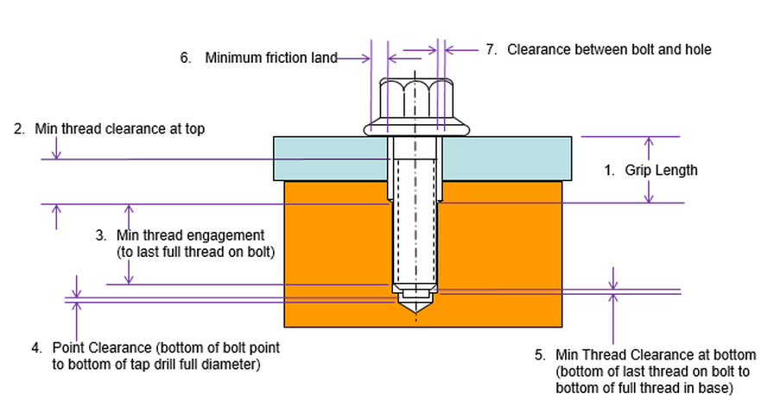
Dimensional tolerances
PURPOSE:
Dimensions are normally applied to orthographic drawings to aid manufacture and construction.
Tolerances are applied to dimensions to allow acceptable variations in manufacturing dimensions.
Uses symbolic language on a drawing to allow for variation on sizes.

Slide 18
Dimensional tolerances
AUDIENCE:
Manufacturer
Fitters (trades)
Construction trades
BENEFIT:
Specifies the degree of accuracy and precision required to make the part to ensure it will function in the product.
A manufacturer cannot make components exactly to the sizes specified on a drawing and requires a range of acceptable variation.
The tolerance specifies these acceptable.

Slide 19
Today’s Task
Create a Gantt Chart for your Project:
Analysing the graphic brief and research (10 marks)
Producing graphic specifications (3 marks for technical graphics; 3 marks for commercial and visual media graphics)
Technical graphics preliminary planning (includes project planning and preliminary graphics) (7 marks)
Commercial and visual media graphics preliminary planning (includes project planning and preliminary graphics) (7 marks)
Graphic solution: technical graphics (25 marks)
Graphic solution: commercial and visual media graphics (25 marks)
Evaluating the solutions and the process (10 marks)

